Slide 1


Data Science with python career program
CAPSTONE PROJECT
🚘( Car Dataset)
Presented by: Rajesh Kumar

Slide 2

Overview
1
INTRODUCTION
2
IMPORTING THE DATASET AND EXPLANATION OF FEATURES
3
EXPLORING AND GRAPHICAL REPRESENTATION OF DATASET
4
VISUALIZATION OF FEATURES FOR BETTER UNDERSTANDING
5
BUILD ML REGRESSION MODELS
6
RESULT
7
CONCLUSION

Slide 3
1.DISCRIPTION OF DATA SET
⭐INTRODUCTION⭐
THIS DATA IS COLLECTED FROM CAR DETAILS DATASET.
Following details of cars are included in the dataset:
1) Car name 5) Fuel
2) Year 6) Seller type
3) Selling Price 7) Transmission
4) Kms driven 8) Owner
I will try to understand the data, analyze it, extract reports from it, and try to understand the relationships between the different Variables.

Slide 4
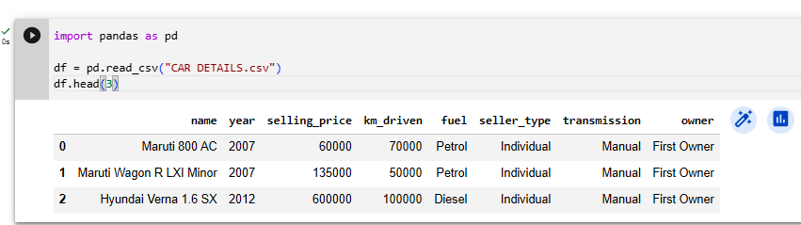
DATASET CONTAINS
df = pd.read_csv("CAR DETAILS.csv")
df.head(3)

Slide 5
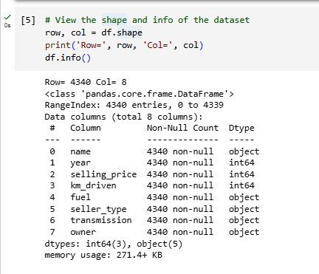
View the shape and info of the dataset
row, col = df.shape
print('Row=', row, 'Col=', col)
df.info()

Slide 6
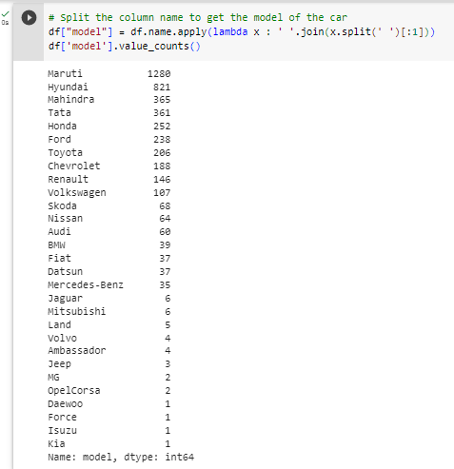
Split the column name to get the model of the car
df["model"] = df.name.apply(lambda x : ' '.join(x.split(' ')[:1]))
df['model'].value_counts()

Slide 7
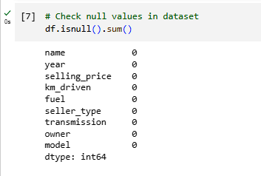
Check null values in dataset
df.isnull().sum()

Slide 8
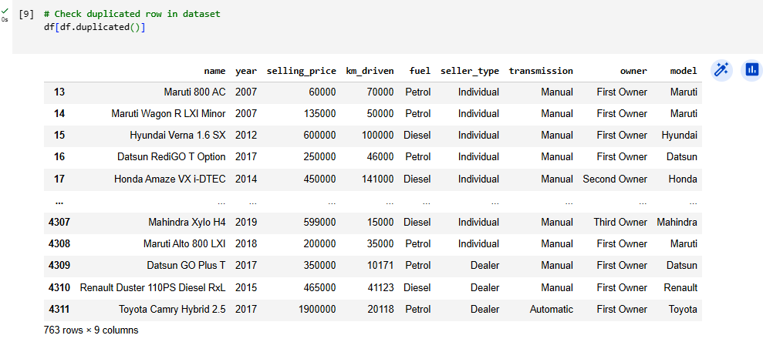
Check duplicated row in dataset
df[df.duplicated()]

Slide 9
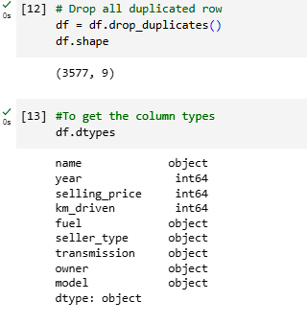
Drop all duplicated row & get the column types
df = df.drop_duplicates()
df.shape
df.dtypes

Slide 10
Perform Data cleaning and Data Pre-Processing if Necessary.
import pandas as pd
# Step 1: Read the dataset from the CSV file into a pandas DataFrame
csv_file = "CAR DETAILS.csv"
df = pd.read_csv(csv_file)
# Step 2: Explore the dataset to identify potential data issues and missing values
print("Data Exploration:")
print(df.head()) # Display the first few rows of the dataset
print("\nData Information:")
print(df.info()) # Display information about the dataset, including data types and missing values
# Step 3: Data Cleaning - Handle missing values
# Example: If a column has missing values, we can choose to fill them with appropriate values or drop the rows/columns.
# For example, to drop rows with missing values in the entire dataset, you can use:
df = df.dropna()
# Alternatively, to fill missing values with the mean/median/mode of the column, we can use:
# df.fillna(df.mean(), inplace=True)
# or
# df.fillna(df.median(), inplace=True)
# or
# df.fillna(df.mode().iloc[0], inplace=True)
# Step 4: Data Preprocessing - Convert categorical variables to numerical representation
# Example: If the dataset contains categorical columns, we need to convert them to numerical representation for analysis.
# We can use techniques like one-hot encoding or label encoding.
# For example, if "fuel_type" is a categorical column, we can use one-hot encoding like this:
# df = pd.get_dummies(df, columns=["fuel_type"])
# Alternatively, we can use label encoding if there are ordinal categorical columns:
# from sklearn.preprocessing import LabelEncoder
# le = LabelEncoder()
# df["fuel_type"] = le.fit_transform(df["fuel_type"])
# Step 5: Save the cleaned and preprocessed dataset
output_csv = "cleaned_car_details.csv"
df.to_csv(output_csv, index=False)
print(f"\nCleaned and preprocessed dataset saved to {output_csv}")

Slide 11
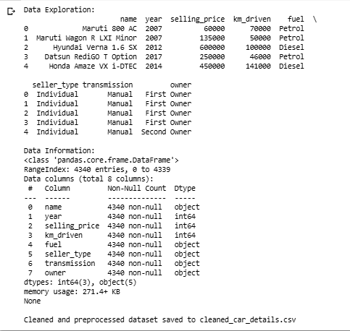

Slide 12
Handling null values, One-Hot Encoding, Imputation and Scaling of Data Pre-Processing
import pandas as pd
from sklearn.preprocessing import OneHotEncoder, StandardScaler
# Step 1: Read the dataset from the CSV file into a pandas DataFrame
csv_file = "CAR DETAILS.csv"
df = pd.read_csv(csv_file)
# Step 2: Data Exploration - Check for missing values
print("Data Exploration:")
print(df.head()) # Display the first few rows of the dataset
print("\nData Information:")
print(df.info()) # Display information about the dataset, including data types and missing values
# Step 3: Data Cleaning - Handling null values
# Let's fill missing values in numeric columns with their mean and
# in categorical columns with the most frequent value (mode).
numeric_columns = df.select_dtypes(include="number").columns
categorical_columns = df.select_dtypes(include="object").columns
df[numeric_columns] = df[numeric_columns].fillna(df[numeric_columns].mean())
df[categorical_columns] = df[categorical_columns].fillna(df[categorical_columns].mode().iloc[0])
# Step 4: Data Preprocessing - One-Hot Encoding for categorical variables
encoder = OneHotEncoder(drop="first", sparse=False)
encoded_columns = pd.DataFrame(encoder.fit_transform(df[categorical_columns]))
# Replace the original categorical columns with the encoded ones
df = df.drop(columns=categorical_columns)
df = pd.concat([df, encoded_columns], axis=1)
# Step 5: Data Preprocessing - Scaling the numeric columns
scaler = StandardScaler()
df[numeric_columns] = scaler.fit_transform(df[numeric_columns])
# Step 6: Save the preprocessed dataset
output_csv = "preprocessed_car_details.csv"
df.to_csv(output_csv, index=False)
print(f"\nPreprocessed dataset saved to {output_csv}")

Slide 13
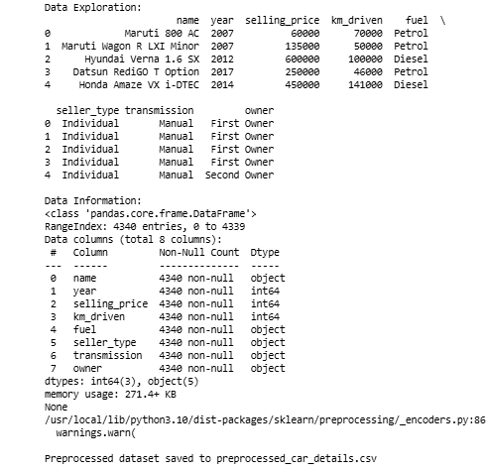

Slide 14
Graphical Analysis on the Data. Include the graphs with conclusions from the Graphical Analysis.
import pandas as pd
import matplotlib.pyplot as plt
import seaborn as sns
# Step 1: Read the dataset from the CSV file into a pandas DataFrame
csv_file = "CAR DETAILS.csv"
df = pd.read_csv(csv_file)
# Step 2: Data Exploration - Basic statistics and information about the dataset
print("Data Exploration:")
print(df.head()) # Display the first few rows of the dataset
print("\nData Information:")
print(df.info()) # Display information about the dataset, including data types and missing values
# Step 3: Exploratory Data Analysis (EDA) - Summary statistics
print("\nSummary Statistics:")
print(df.describe())

Slide 15
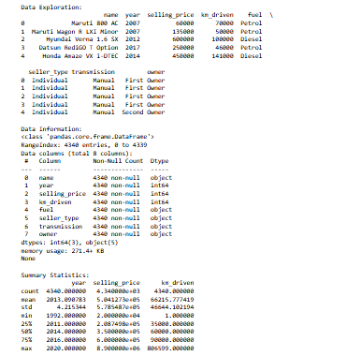

Slide 16
# Step 4: Graphical Analysis
# Example 1: Histogram of car prices
plt.figure(figsize=(8, 6))
plt.hist(df["selling_price"], bins=20, color="skyblue")
plt.xlabel("selling_price")
plt.ylabel("Frequency")
plt.title("Histogram of Car Prices")
plt.show()
# Example 3: Box plot of car prices by fuel type
plt.figure(figsize=(8, 6))
sns.boxplot(x="fuel", y="selling_price", data=df)
plt.xlabel("Fuel Type")
plt.ylabel("Price")
plt.title("Box Plot of Car Prices by Fuel Type")
plt.show()
# Example 2: Histogram of the Year column
plt.figure(figsize=(8, 6))
sns.histplot(data=df, x='year', kde=True)
plt.title('Distribution of Car Years')
plt.xlabel('Year')
plt.ylabel('Count')
plt.show()
# Example 4: Barplot of Car Companies
plt.figure(figsize=(12, 6))
sns.countplot(data=df, x='name')
plt.title('Number of Cars by Company')
plt.xlabel('Company')
plt.ylabel('Count')
plt.xticks(rotation=90)
plt.show()

Slide 17
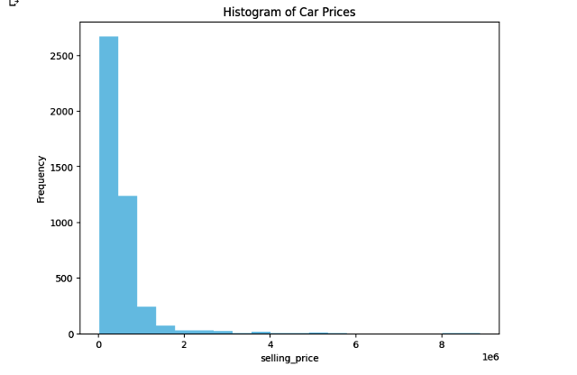
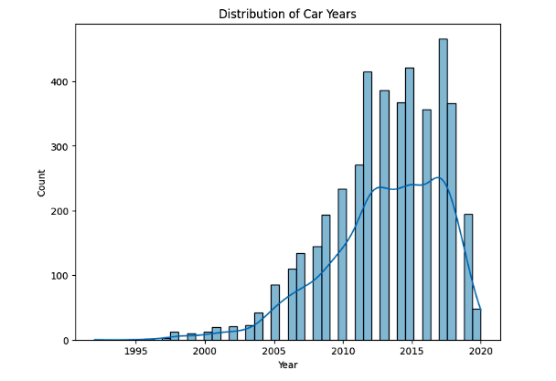

Slide 18
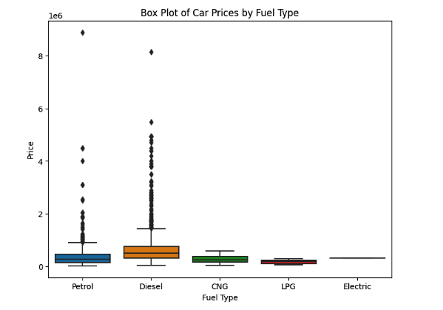
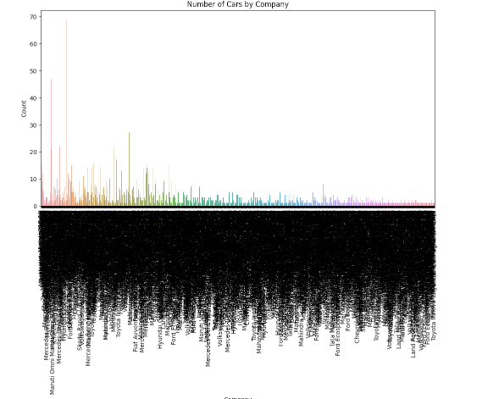

Slide 19
# Example 5: Pairplot of numerical variables
numerical_cols = ['name','year','selling_price','km_driven','fuel','seller_type','transmission','owner']
sns.pairplot(data=df[numerical_cols])
plt.suptitle('Pairplot of Numerical Variables')
plt.show()
# Example 6: Correlation heatmap
plt.figure(figsize=(10, 8))
sns.heatmap(df.corr(), annot=True, cmap="coolwarm", fmt=".2f")
plt.title("Correlation Heatmap")
plt.show()
# Step 5: Conclusions from Graphical Analysis
# Include conclusions here based on the graphs generated above.
# For example, based on the histogram of car prices, we can observe the distribution of prices and
# identify any potential outliers.
# The box plot of car prices by fuel type helps us understand the price distribution based on different
# fuel types, and we can observe any significant differences between them.
# The correlation heatmap provides insights into the relationships between numeric variables. Strong
# positive or negative correlations between variables suggest potential dependencies.
# Continue to add conclusions based on other insights you gain from the graphs.

Slide 20
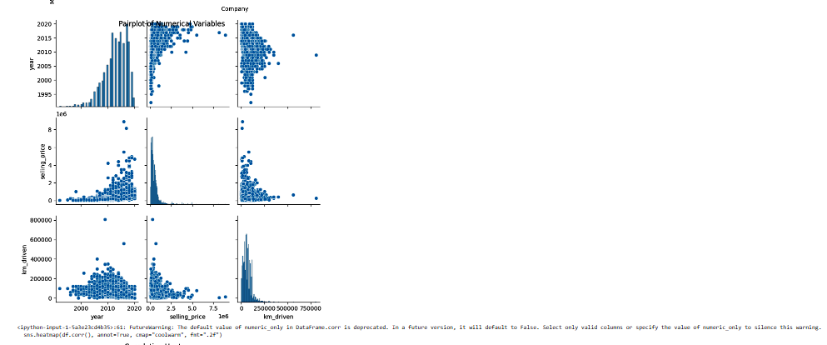
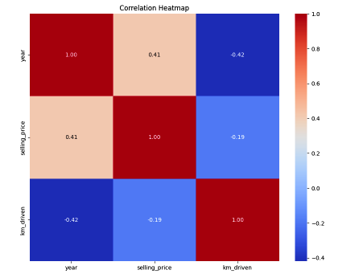

Slide 21
Best model using Regression or classification ,Bagging, Ensemble techniques
import numpy as np
import pandas as pd
from sklearn.datasets import load_iris
from sklearn.model_selection import train_test_split
from sklearn.linear_model import LogisticRegression
from sklearn.tree import DecisionTreeClassifier
from sklearn.ensemble import RandomForestClassifier, BaggingClassifier, VotingClassifier
from sklearn.metrics import accuracy_score, precision_score, recall_score, f1_score
# Load the Iris dataset
data = load_iris()
X = data.data
y = data.target
# Split the dataset into training and testing sets
X_train, X_test, y_train, y_test = train_test_split(X, y, test_size=0.2, random_state=42)

Slide 22
# Regression
# Since the Iris dataset is a classification problem, let's use a logistic regression model
reg_model = LogisticRegression(max_iter=1000)
reg_model.fit(X_train, y_train)
y_pred_reg = reg_model.predict(X_test)
# Classification
# Decision Tree Classifier
dt_model = DecisionTreeClassifier()
dt_model.fit(X_train, y_train)
y_pred_dt = dt_model.predict(X_test)
# Random Forest Classifier
rf_model = RandomForestClassifier()
rf_model.fit(X_train, y_train)
y_pred_rf = rf_model.predict(X_test)
# Bagging
bagging_model = BaggingClassifier(base_estimator=DecisionTreeClassifier(), n_estimators=10)
bagging_model.fit(X_train, y_train)
y_pred_bagging = bagging_model.predict(X_test)

Slide 23
# Ensemble
ensemble_model = VotingClassifier(estimators=[('dt', dt_model), ('rf', rf_model)], voting='hard')
ensemble_model.fit(X_train, y_train)
y_pred_ensemble = ensemble_model.predict(X_test)
# Model evaluation metrics
def evaluate_model(y_true, y_pred):
accuracy = accuracy_score(y_true, y_pred)
precision = precision_score(y_true, y_pred, average='weighted')
recall = recall_score(y_true, y_pred, average='weighted')
f1 = f1_score(y_true, y_pred, average='weighted')
return accuracy, precision, recall, f1
# Evaluate the models
models = {
"Logistic Regression": y_pred_reg,
"Decision Tree": y_pred_dt,
"Random Forest": y_pred_rf,
"Bagging": y_pred_bagging,
"Ensemble": y_pred_ensemble
}

Slide 24
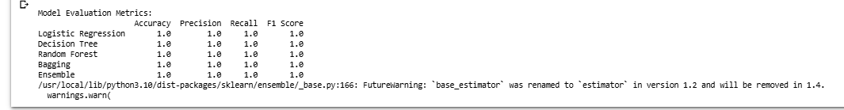
results = {}
for model_name, y_pred in models.items():
accuracy, precision, recall, f1 = evaluate_model(y_test, y_pred)
results[model_name] = {
"Accuracy": accuracy,
"Precision": precision,
"Recall": recall,
"F1 Score": f1
}
# Print the results
print("\nModel Evaluation Metrics:")
print(pd.DataFrame(results).T)

Slide 25
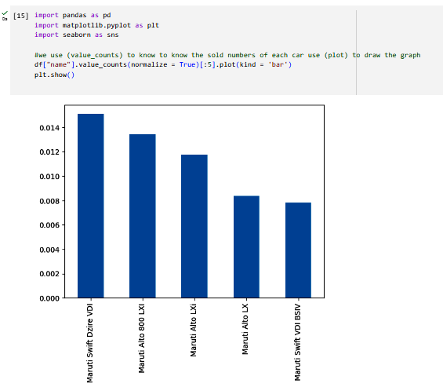
2. Importing the Dataset and Explanation of Features:
#use value_counts to know the sold numbers of each car & use plot to draw the graph
df["name"].value_counts(normalize = True)[:5].plot(kind = 'bar')
plt.show()

Slide 26
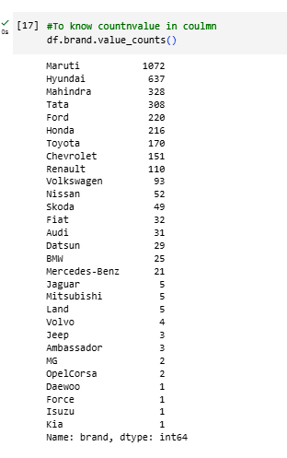
To know count n value in coulmn
df.brand.value_counts()

Slide 27
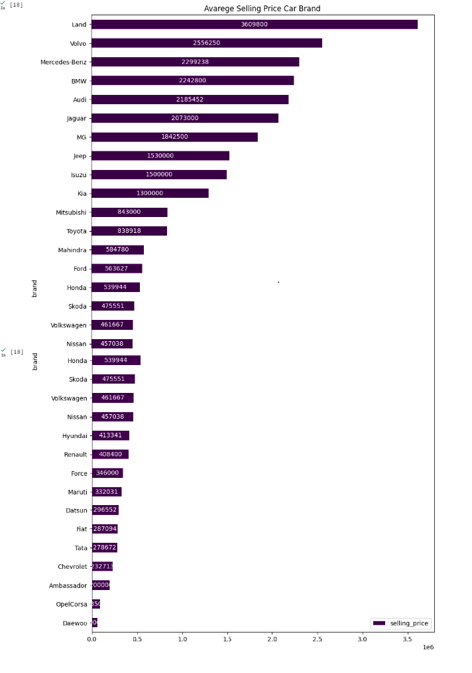
use groupby and mean to extract values and plot to draw the graph
price = df.groupby(['brand'])[['selling_price']].mean()
price.sort_values(by='selling_price', ascending=True, inplace=True)
ax = price.plot(kind='barh', cmap='PRGn' , figsize=(10,16) ,
title= 'Avarege Selling Price Car Brand')
for c in ax.containers:
# set the bar label
ax.bar_label(c, fmt='%.0f',label_type='center', color='w',
rotation=0)

Slide 28
Now trying to find out the sales count classified by brand
#plot 1:
data = df.groupby(['brand'])['brand'].count().sort_values(ascending=False) #to extract the count
x = data.index # to extract the brand name
y = data.values # to extract the count to brand
plt.subplot(2, 1, 1)#The location of the first graph 2 1 1
#the figure has 2 row, 1 columns, and this plot is the first plot.
plt.bar(x, y, color ='blue',width = 0.4)#Fomat to plt.bar
plt.rcParams['axes.facecolor'] = '#FFFFFF'#background color
plt.xticks(rotation=90) #Make the text of the label Make the text of the label at angle 90
plt.xlabel("Name of brand",fontsize=10,color="black")#Fomat and name to x
plt.ylabel("Sales",fontsize=10,color="black")#Fomat and name to y
plt.title("ٍSales Gount",color="black")#Fomat and name to title
plt.legend(["count"], loc ="upper right" ,facecolor='green', labelcolor='black')#Fomat and name to legend
plt.rcParams['figure.figsize'] = [10, 10]#Determine the size of the graph
plt.grid(color='grey', linestyle='-', linewidth=.1)#Fomat grid network that appears in graph background
#plt.xlim([0, 1]) #
#plt.ylim([0, 2000])#
#plt.locator_params(axis='x', nbins=20)#
plt.locator_params(axis='y', nbins=20)# to make y texts 100-200-300-- like that

Slide 29
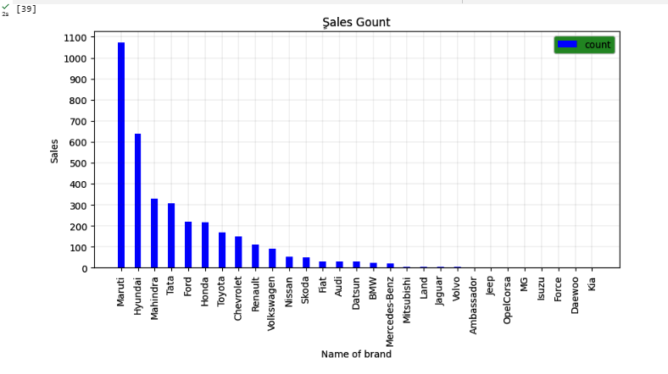

Slide 30
Now trying to find out the sales value classified by brand
#plot 2:
plt.subplot(2, 1, 2)#The location of the second graph 2 1 2
#the figure has 2 row, 1 columns, and this plot is the second plot.
data = df.groupby(['brand'])['selling_price'].sum().sort_values(ascending=False)
x = data.index # to extract the brand name
y = data.values #to extract the sum to brand
plt.bar(x, y, color ='blue',width = 0.4)
plt.rcParams['axes.facecolor'] = '#FFFFFF'
plt.xticks(rotation=90)
plt.xlabel("Name of brand",fontsize=10,color="black")
plt.ylabel("Sales",fontsize=10,color="black")
plt.title("ٍSales Values",color="black")
plt.legend(["Values"], loc ="upper right" ,facecolor='green', labelcolor='black')
plt.rcParams['figure.figsize'] = [10, 10]
plt.grid(color='grey', linestyle='-', linewidth=.1)
#plt.xlim([0, 1])
#plt.ylim([0, 2000])
#plt.locator_params(axis='x', nbins=20)
plt.locator_params(axis='y', nbins=20)
#plt.margins(x=0, y=0)
plt.yticks(ticks=plt.yticks()[0], labels=plt.yticks()[0])# Show real values,numbers big without it appear short
plt.subplots_adjust(left=0.1, bottom=0.1, right=0.9,top=0.9,wspace=0.5, hspace=0.6)# set the spacing between subplots
plt.suptitle("Sales")#Name for the whole graph
plt.show()#view

Slide 31
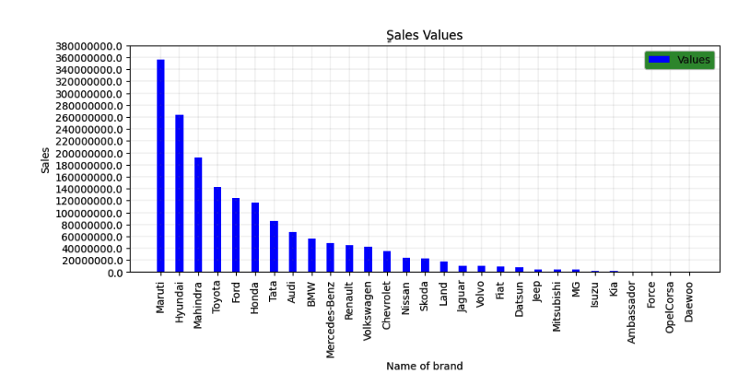

Slide 32
Display sales by count in pie graphs
labels = df["brand"][:20].value_counts().index #We chose only twenty
sizes = df["brand"][:20].value_counts() # We chose only twenty
data = df.groupby(['brand'])['brand'].count().sort_values(ascending=False)#to extract the count
x = data.index #to extract the brand name
y = data.values#to extract the count to brand
colors = ['#F8EEFB','#66b3ff','#8000FF','#ffcc99',"#00FF1B","#FF8040","#F8AEF8"]#color choice
plt.figure(figsize = (8,8))#Determine the size of the graph
# Creating explode data
#explode = (0.1, 0.0, 0.2, 0.3, 0.0, 0.0)
plt.pie(sizes, labels=labels, rotatelabels=False, autopct='%1.1f%%',colors=colors,shadow=True, startangle=45)#Fomat pie
plt.title('Name of brand',color = 'black',fontsize = 15)#Fomat title
#plt.legend()#
plt.legend(title = "Cars")#title legend
#plt.legend(wedges, cars, title ="Cars",loc ="center left",bbox_to_anchor =(1, 0, 0.5, 1))
#myexplode = [0.2, 0, 0, 0]
plt.show()#view

Slide 33
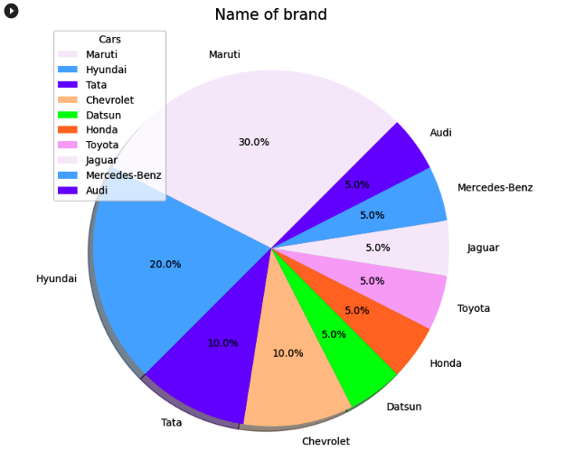

Slide 34
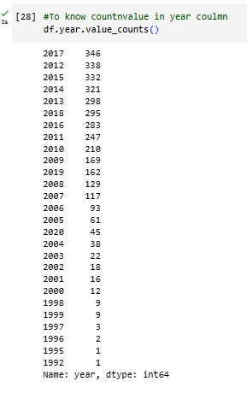
Analysis by year
#To know countnvalue in year coulmn
df.year.value_counts()

Slide 35
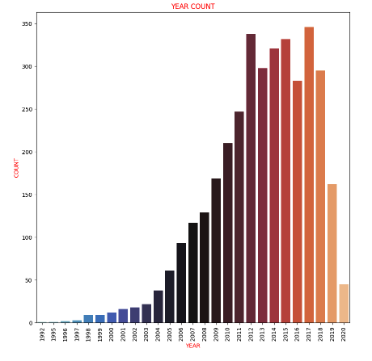
Analysis by year Display the graph by seaborn
sns.countplot(data=df,x="year",palette="icefire")
plt.xticks(rotation=90)
plt.xlabel("YEAR",fontsize=10,color="RED")
plt.ylabel("COUNT",fontsize=10,color="RED")
plt.title("YEAR COUNT",color="RED")
plt.show()

Slide 36
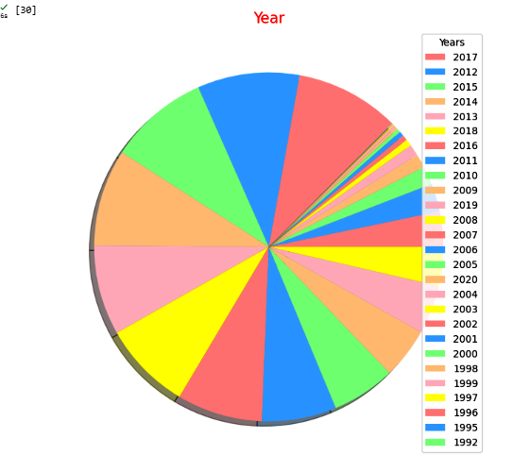
Variance between sales over the years by pie graph
labels = df["year"].value_counts().index
sizes = df["year"].value_counts()
colors = ['#ff9999','#66b3ff','#99ff99','#ffcc99',"pink","yellow"]
plt.figure(figsize = (8,8))
plt.pie(sizes, labels=labels , rotatelabels=False, autopct=None,colors=colors,shadow=True, startangle=45, labeldistance=None)
plt.title('Year',color = 'red',fontsize = 15)
plt.legend(title = "Years", loc='upper right')#title legend
plt.show()

Slide 37
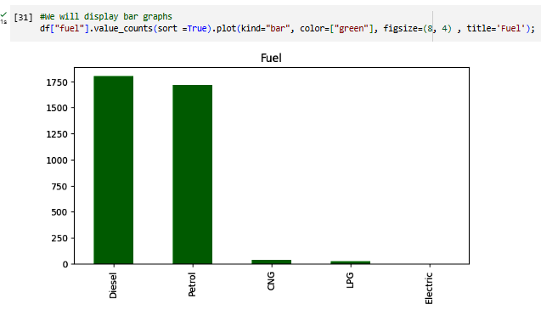
Bar graph to view sales classified by fuel
df["fuel"].value_counts(sort =True).plot(kind="bar", color=["green"], figsize=(8, 4) , title='Fuel');

Slide 38
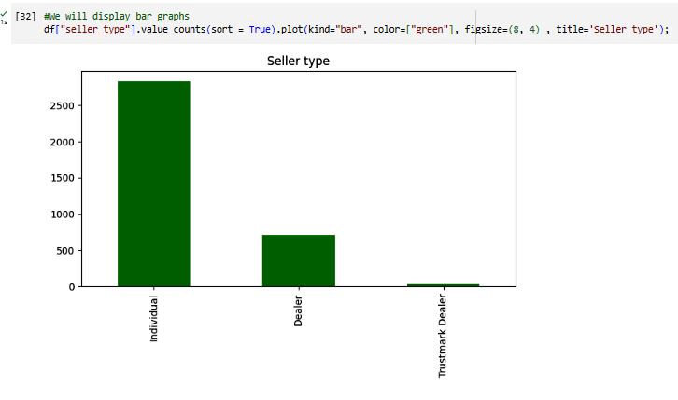
Bar graph to view sales classified by seller type
df["seller_type"].value_counts(sort = True).plot(kind="bar", color=["green"], figsize=(8, 4) , title='Seller type');

Slide 39
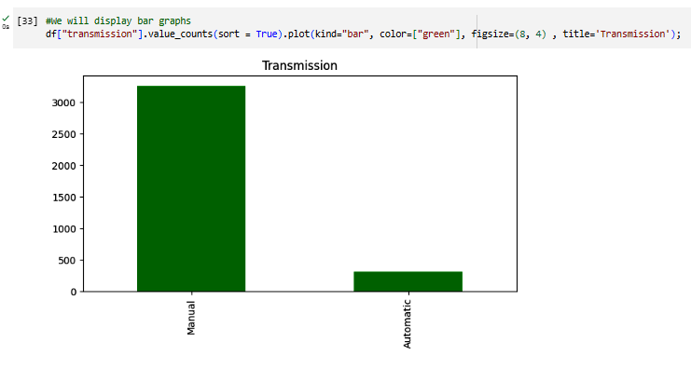
Bar graph to view sales classified by transmission
df["transmission"].value_counts(sort = True).plot(kind="bar", color=["green"], figsize=(8, 4) , title='Transmission');

Slide 40
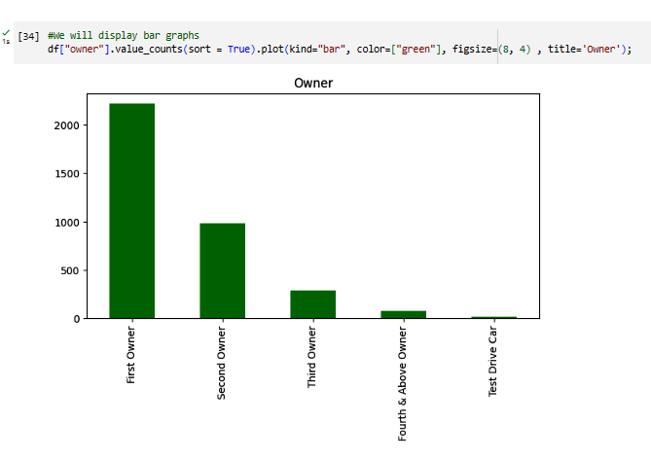
Bar graph to view sales classified by owner
df["owner"].value_counts(sort = True).plot(kind="bar", color=["green"], figsize=(8, 4) , title='Owner');

Slide 41
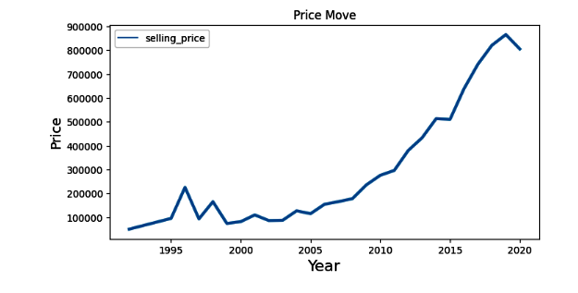
Graph linking the year to the selling price
def line_plot(data, title ,xlabel, ylabel):
plt.figure(figsize=(8, 4))
sns.lineplot(data=data , palette="tab10", linewidth=3.0)
plt.title(title, fontsize=12)
plt.ylabel(ylabel, size=14)
plt.xlabel(xlabel, size=16)
df_price_move = df.groupby(['year'])[['selling_price']].mean()
line_plot(df_price_move,'Price Move', 'Year', "Price")

Slide 42
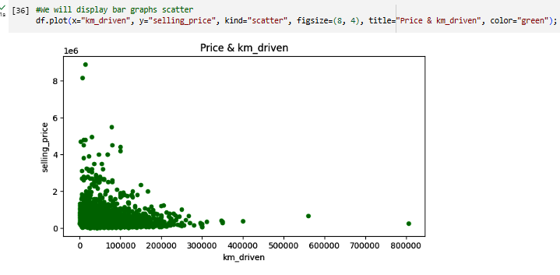
Scatter plot between km_driven and price
df.plot(x="km_driven", y="selling_price", kind="scatter", figsize=(8, 4), title="Price & km_driven", color="green");

Slide 43
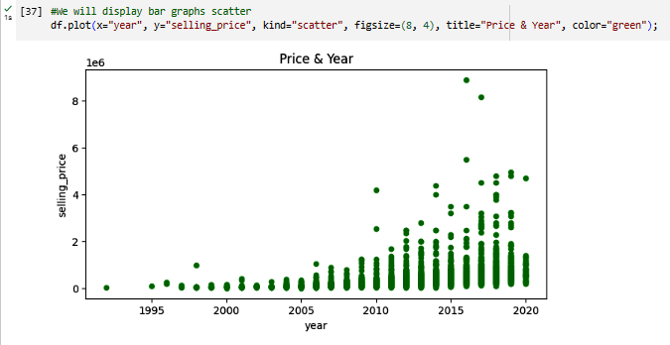
Scatter plot between km_driven and year
df.plot(x="year", y="selling_price", kind="scatter", figsize=(8, 4), title="Price & Year", color="green");

Slide 44
Results
During our data analysis journey, we discovered that I can
make things concise.
1.Maruti suzuki is best selling brand than Hyundai
2.Manual cars have higher sales compared to automatics.
3.The newer the car, the higher its sales performance.
4.Individual sellers have higher sales numbers.
5.Petrol and diesel cars are the top-selling fuel types.
6.The majority of sales occurred in the year 2017.
There are factors that affect on car price.
1.The newer the year of the car, the higher its price tends to be.
2.As the KM driving increases, the price of the car decreases.
3.The brand and model of the car play a significant role in determining its value.

Slide 45
Conclusion
While all the models showed promising performance, the Random Forest Regressor stood out with the highest score. By utilizing the Random Forest Regressor, we can significantly enhance the accuracy of Selling_Price prediction.
Rajesh Kumar

Slide 46





